Slide 1
Chapter 5: CPU Scheduling

Slide 2
Chapter 5: CPU Scheduling
Basic Concepts
Scheduling Criteria
Scheduling Algorithms
Thread Scheduling
Multiple-Processor Scheduling
Operating Systems Examples
Algorithm Evaluation

Slide 3
Objectives
To introduce CPU scheduling, which is the basis for multiprogrammed operating systems
To describe various CPU-scheduling algorithms
To discuss evaluation criteria for selecting a CPU-scheduling algorithm for a particular system

Slide 4
Basic Concepts
Maximum CPU utilization obtained with multiprogramming
CPU–I/O Burst Cycle – Process execution consists of a cycle of CPU execution and I/O wait
CPU burst distribution

Slide 5
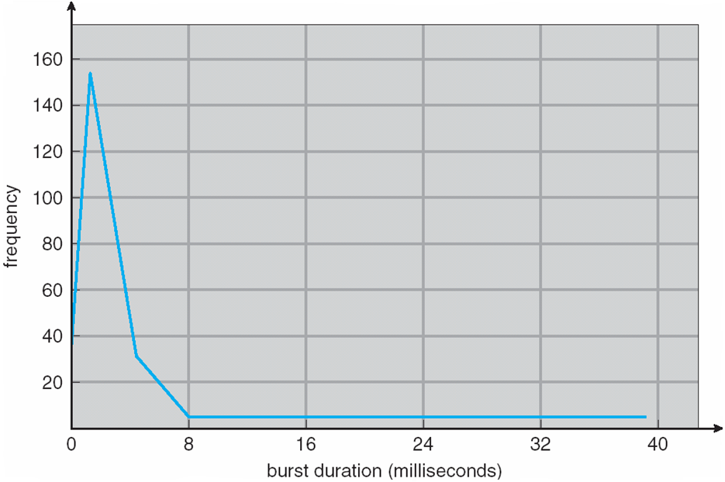
Histogram of CPU-burst Times

Slide 6
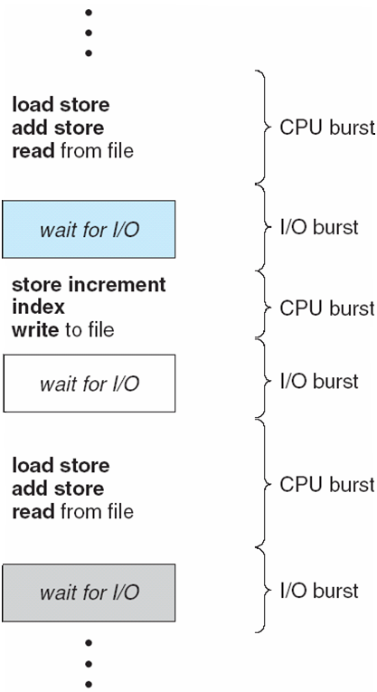
Alternating Sequence of CPU and I/O Bursts

Slide 7
CPU Scheduler
Whenever the CPU becomes idle, the OS must select one of the processes in the ready queue to be executed. The selection process is carried out by the CPU scheduler(Short term scheduler)
CPU scheduling decisions may take place under the following four circumstances when a process:
1. Switches from running to waiting state
2. Switches from running to ready state
3. Switches from waiting to ready
Terminates
Scheduling under 1 and 4 is non-preemptive
All other scheduling is preemptive – implications for data sharing between threads/processes

Slide 8
Dispatcher
Dispatcher module gives control of the CPU to the process selected by the scheduler; this involves:
switching context
switching to user mode
jumping to the proper location in the user program to restart that program
Dispatch latency – time it takes for the dispatcher to stop one process and start another running

Slide 9
Scheduling Criteria-
CPU utilization – We want to keep the CPU as busy as possible. The CPU utilization can range from 0 to 100 percent. In a real system, for lightly loaded system should vary from 40 to 90 percent(heavily used system)
Throughput –The number of processes that complete their execution per time unit, is called throughput. For long processes ,this rate may be done one process per hour ,for short transactions ,it may be 10 processes per second,

Slide 10
Scheduling Criteria-
Turnaround time – How long it takes to execute that process. The interval from the time of submission of a process to the time of completion is the turn around time.
Turnaround time is the sum of periods spent waiting to get into memory, waiting in the ready queue, executing on the cpu, and doing I/O.

Slide 11
Scheduling Criteria-
Waiting time – The amount of time that process spends waiting in the ready queue. It is the sum of the periods spent waiting in the ready queue.
Response Time-
It is the measure that specifies the first respond from the submission of the request.

Slide 12
Scheduling Algorithm Optimization Criteria
The following are desirable
Max CPU utilization
Max throughput
Min turnaround time
Min waiting time
Min response time

Slide 13
Preemptive Scheduling is a CPU scheduling technique that works by dividing time slots of CPU to a given process. The time slot given might be able to complete the whole process or might not be able to it. When the burst time of the process is greater than CPU cycle, it is placed back into the ready queue and will execute in the next chance. This scheduling is used when the process switch to ready state.

Slide 14
Non-preemptive Scheduling is a CPU scheduling technique the process takes the resource (CPU time) and holds it till the process gets terminated or is pushed to the waiting state. No process is interrupted until it is completed, and after that processor switches to another process.

Slide 15
FCFS
First Come First Serve
First come first serve (FCFS) scheduling algorithm simply schedules the jobs according to their arrival time. The job which comes first in the ready queue will get the CPU first.

Slide 16
First-Come, First-Served (FCFS) Scheduling
Process Burst Time
P₁ 24
P₂ 3
P₃ 3
Suppose that the processes arrive in the order: P₁ , P₂ , P₃ The Gantt Chart for the schedule is:
Waiting time for P₁ = 0; P₂ = 24; P₃ = 27
Average waiting time: (0 + 24 + 27)/3 = 17
P₁
P₂
P₃
0
24
27
30

Slide 17
FCFS Scheduling (Cont.)
Suppose that the processes arrive in the order:
P₂ , P₃ , P₁
The Gantt chart for the schedule is:
Waiting time for P₁ = 6; P₂ = 0; P₃ = 3
Average waiting time: (6 + 0 + 3)/3 = 3
Much better than previous case
P₂
P₃
P₁
0
3
6
30

Slide 18
Advantages of FCFS
Simple
Easy
Disadvantages of FCFS
The scheduling method is non preemptive, the process will run to the completion.
Due to the non-preemptive nature of the algorithm, the problem of starvation may occur.
Although it is easy to implement, but it is poor in performance since the average waiting time is higher as compare to other scheduling algorithms.

Slide 19
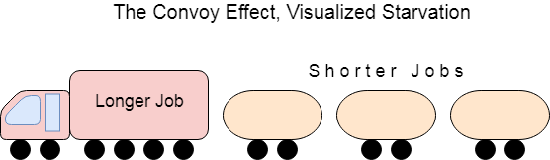
Disadvantages
If the CPU gets the processes of the higher burst time at the front end of the ready queue then the processes of lower burst time may get blocked which means they may never get the CPU if the job in the execution has a very high burst time. This is called convoy effect or starvation.

Slide 20
Shortest-Job-First (SJF) Scheduling
SJF scheduling algorithm, schedules the processes according to their burst time.
In SJF scheduling, the process with the lowest burst time, among the list of available processes in the ready queue, is going to be scheduled next.
Associate with each process the length of its next CPU burst. Use these lengths to schedule the process with the shortest time.

Slide 21
SJF is optimal – gives minimum average waiting time for a given set of processes
The difficulty is knowing the length of the next CPU request.

Slide 22
Example of SJF
Process Arrival Time Burst Time
P₁ 0.0 6
P₂ 2.0 8
P₃ 4.0 7
P₄ 5.0 3
SJF scheduling chart
Average waiting time = (3 + 16 + 9 + 0) / 4 = 7
P₄
P₁
P₃
P₂
0
3
9
16
24

Slide 23
Advantages of SJF
Maximum throughput
Minimum average waiting and turnaround time
Disadvantages of SJF
May suffer with the problem of starvation
It is not implementable because the exact Burst time for a process can't be known in advance.

Slide 24
Determining Length of Next CPU Burst
Can only estimate the length
Can be done by using the length of previous CPU bursts, using exponential averaging
τ _{n+1} = α t _{n} + (1- α) τ _{n}.

Slide 25
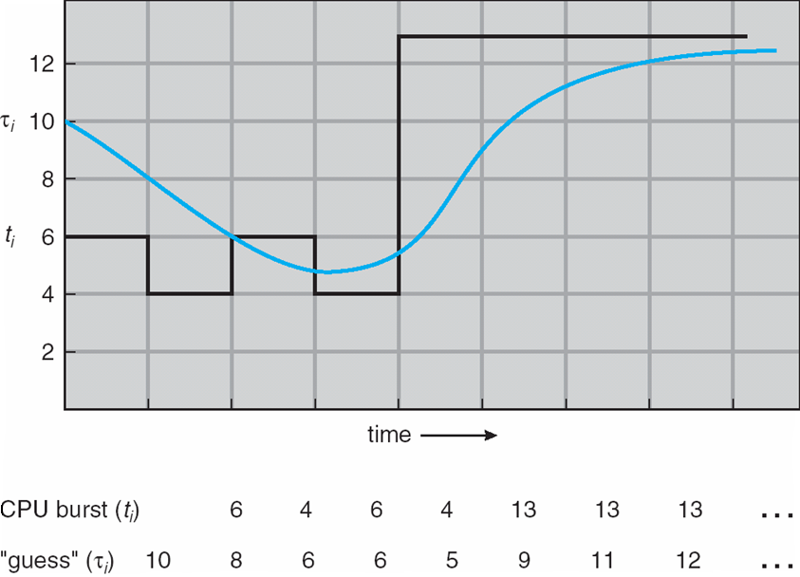
Prediction of the Length of the Next CPU Burst

Slide 26
Examples of Exponential Averaging
α =0
τ_{n+1} = τ_{n}
Recent history does not count.
α =1
τ_{n+1} = α t_{n}
Only the actual last CPU burst counts.
If we expand the formula, we get:
τ_{n+1} = α t_{n}+(1 - α)α t_{n} -1 + …
+(1 - α )^{j} α t_{n} _{-j} + …
+(1 - α )^{n +1} τ₀
Since both α and (1 - α) are less than or equal to 1, each successive term has less weight than its predecessor.

Slide 27
Shortest Remaining Time First (SRTF) Scheduling Algorithm
Shortest Remaining Time First (SRTF) Scheduling Algorithm
This Algorithm is the preemptive version of SJF scheduling. In SRTF, the execution of the process can be stopped after certain amount of time.
At the arrival of every process, the short term scheduler schedules the process with the least remaining burst time among the list of available processes and the running process.

Slide 28
SRTF
Once all the processes are available in the ready queue, No preemption will be done and the algorithm will work as SJF scheduling. The context of the process is saved in the Process Control Block when the process is removed from the execution and the next process is scheduled. This PCB is accessed on the next execution of this process.

Slide 29
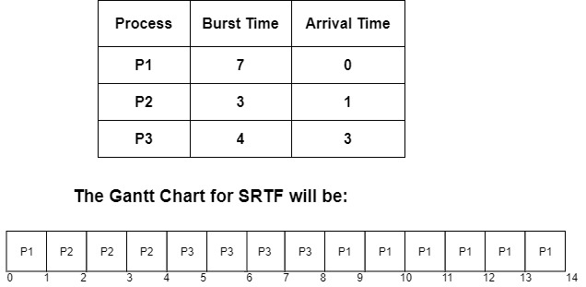
SRTF-Example

Slide 30
Explanation
At the 0th unit of the CPU, there is only one process that is P1, so P1 gets executed for the 1 time unit.
At the 1st unit of the CPU, Process P2 arrives. Now, the P1 needs 6 more units more to be executed, and the P2 needs only 3 units. So, P2 is executed first by preempting P1.

Slide 31
At the 3rd unit of time, the process P3 arrives, and the burst time of P3 is 4 units which is more than the completion time of P2 that is 1 unit, so P2 continues its execution.
Now after the completion of P2, the burst time of P3 is 4 units that means it needs only 4 units for completion while P1 needs 6 units for completion.

Slide 32
So, this algorithm picks P3 above P1 due to the reason that the completion time of P3 is less than that of P1
P3 gets completed at time unit 8, there are no new processes arrived.
So again, P1 is sent for execution, and it gets completed at the 14th unit.

Slide 33
As Arrival Time and Burst time for three processes P1, P2, P3 are given in the above diagram. Let us calculate Turn around time, completion time, and waiting time.

Slide 35
Process | Arrival Time | Burst Time | Completion time | Turn Around Time = Completion Time – Arrival Time | Waiting Time = Turn Around Time – Burst Time
P1 | 0 | 7 | 14 | 14-0=14 | 14-7=7
P2 | 1 | 3 | 4 | 4-1=3 | 3-3=0
P3 | 3 | 4 | 8 | 8-3=5 | 5-4=1

Slide 36
Average waiting time is calculated by adding the waiting time of all processes and then dividing them by no. of processes.
average waiting time = waiting for time of all processes/ no.of processes
average waiting time=7+0+1=8/3 = 2.66ms

Slide 37
Priority Scheduling
A priority number (integer) is associated with each process
The CPU is allocated to the process with the highest priority (smallest integer ≡ highest priority)
Preemptive
Non-preemptive
Note that SJF is a priority scheduling where priority is the predicted next CPU burst time
Problem ≡ Starvation – low priority processes may never execute
Solution ≡ Aging – as time progresses increase the priority of the process

Slide 38
Round Robin (RR)
Each process gets a small unit of CPU time (time quantum), usually 10-100 milliseconds. After this time has elapsed, the process is preempted and added to the end of the ready queue.
We can predict wait time: If there are n processes in the ready queue and the time quantum is q, then each process gets 1/n of the CPU time in chunks of at most q time units at once. No process waits more than (n-1)q time units.
Performance
q large ⇒ FIFO
q small ⇒ may hit the context switch wall: q must be large with respect to context switch, otherwise overhead is too high

Slide 39
Example of RR with Time Quantum = 4
Process Burst Time
P₁ 24
P₂ 3
P₃ 3
The Gantt chart is:
Typically, higher average turnaround than SJF, but better response
P₁
P₂
P₃
P₁
P₁
P₁
P₁
P₁
0
4
7
10
14
18
22
26
30

Slide 40
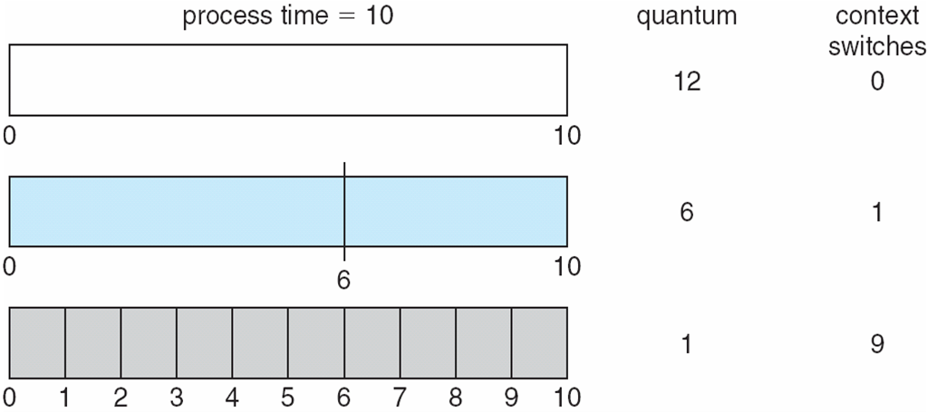
Time Quantum and Context Switch Time

Slide 41
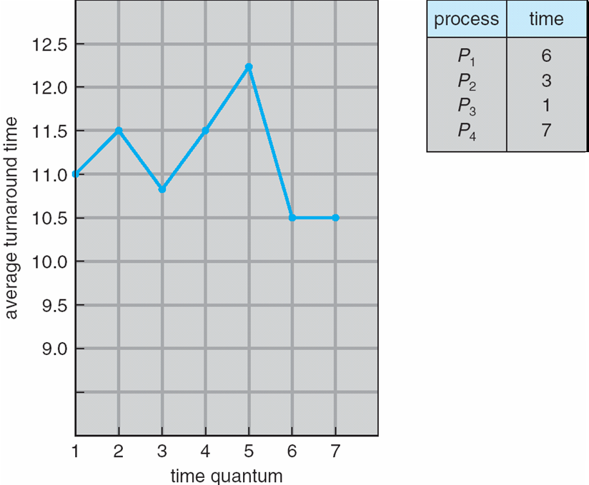
Turnaround Time Varies With The Time Quantum

Slide 42
End of Chapter 5

